Slide 1
Towards generic Visual-Inertial Odometry
Julian Surber
Semester Thesis
Supervised by Margarita Chli & Lucas Pinto Teixeira

Slide 2
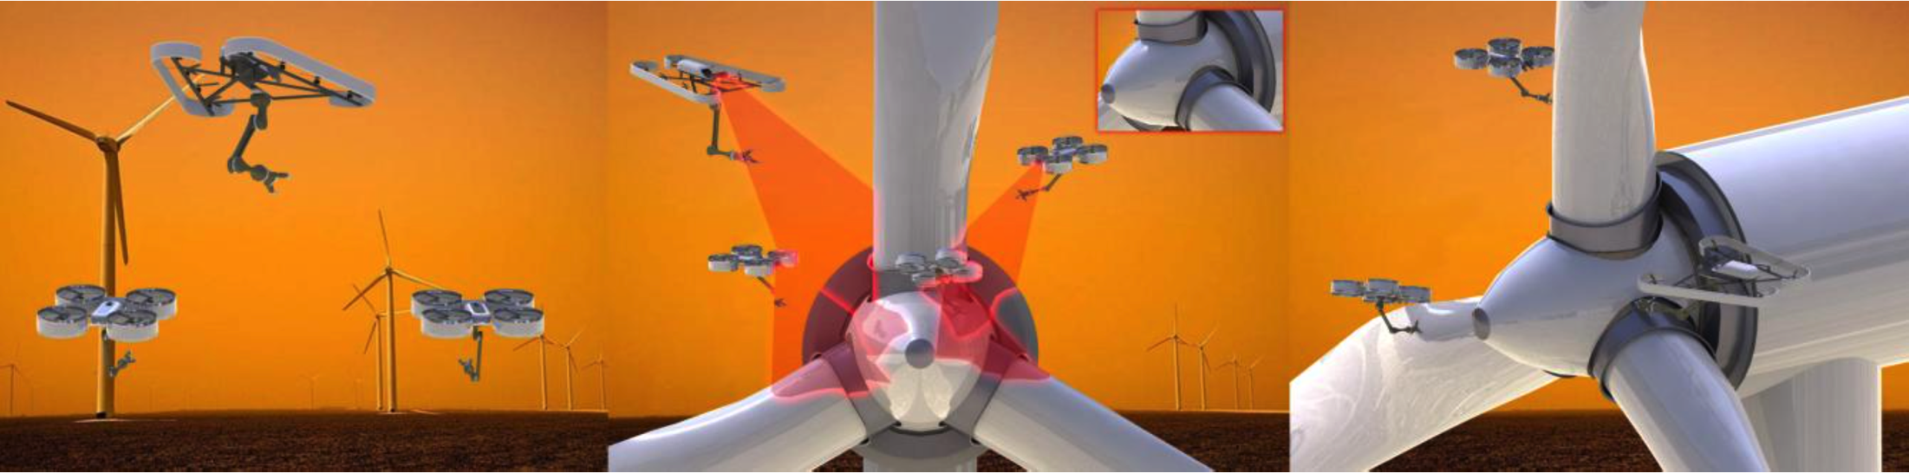
One key challenge: single robot localization
Global and local
Visual-inertial odometry
Complementary properties
Lightweight
Passive
Onboard

Slide 3
ROVIO and OKVIS
Time-Synchronization
Outlook

Slide 4
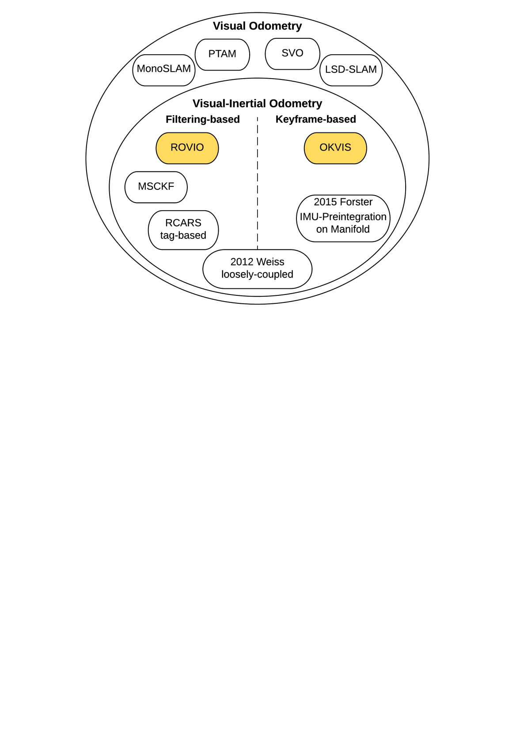
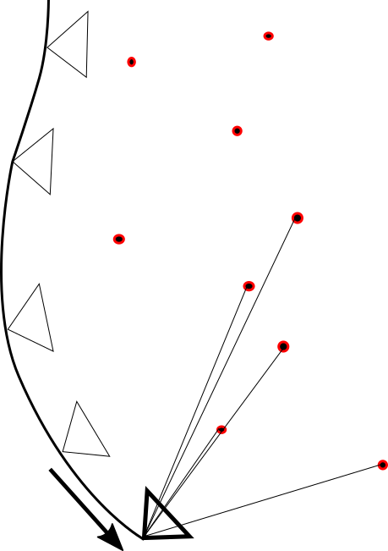
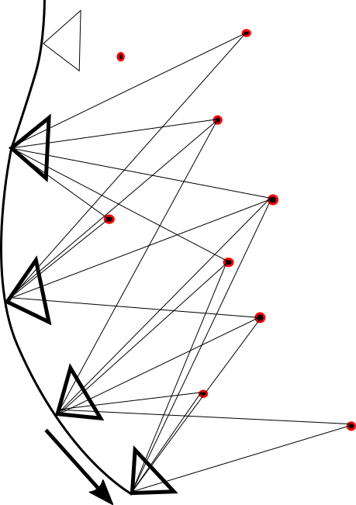
Overview
ROVIO and OKVIS
Time-Synchronization
Outlook
¹
²
¹ [Blösch et al., IROS, 2015]
² [Leutenegger et al., IJRR, 2015]

Slide 5
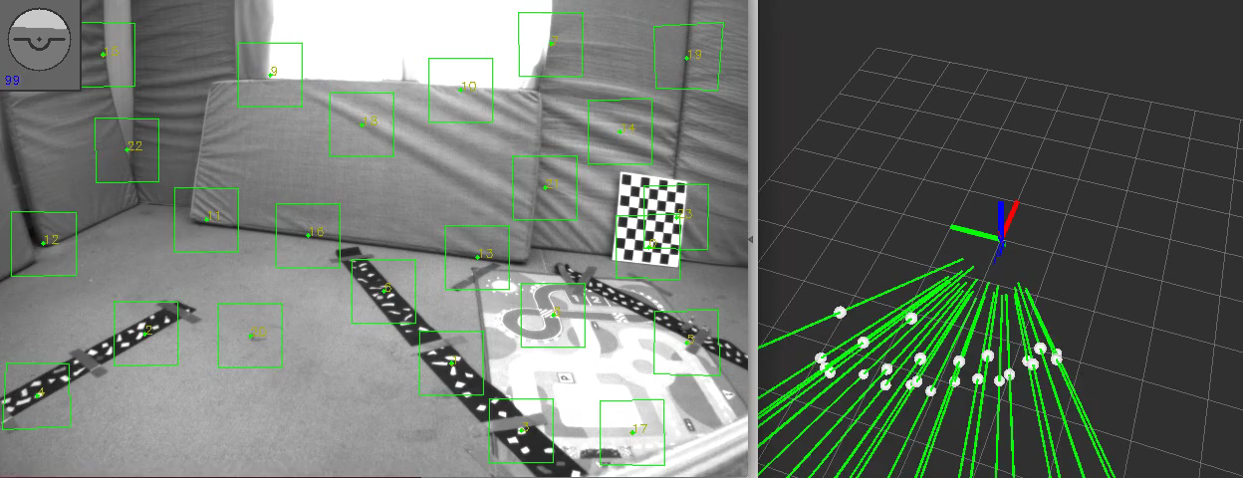
ROVIO – Robust Visual Inertial Odometry Using a Direct EKF-Based Approach
ROVIO and OKVIS
Time-Synchronization
Outlook

Slide 6
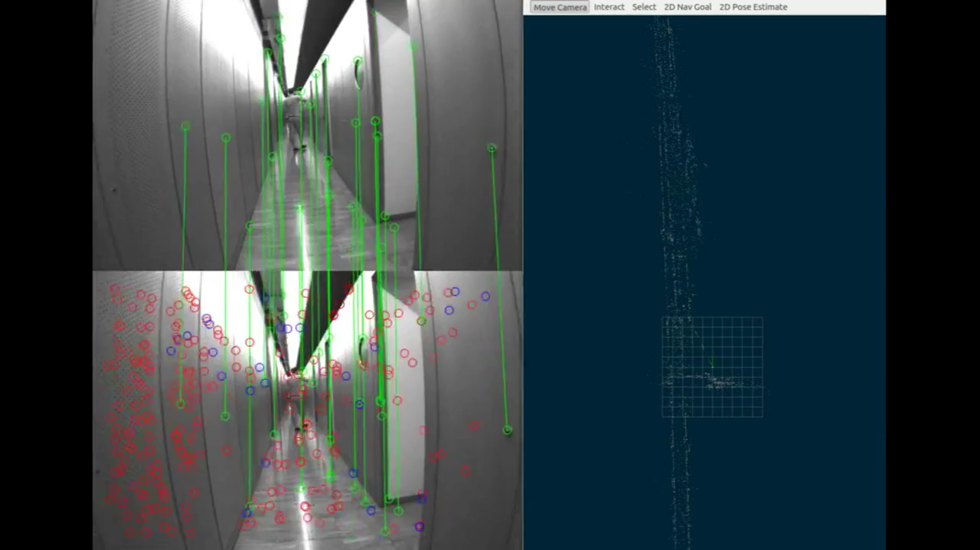
OKVIS – Optimal Keyframe-Based VI SLAM
ROVIO and OKVIS
Time-Synchronization
Outlook
[Leutenegger et al., IJRR, 2015]

Slide 7
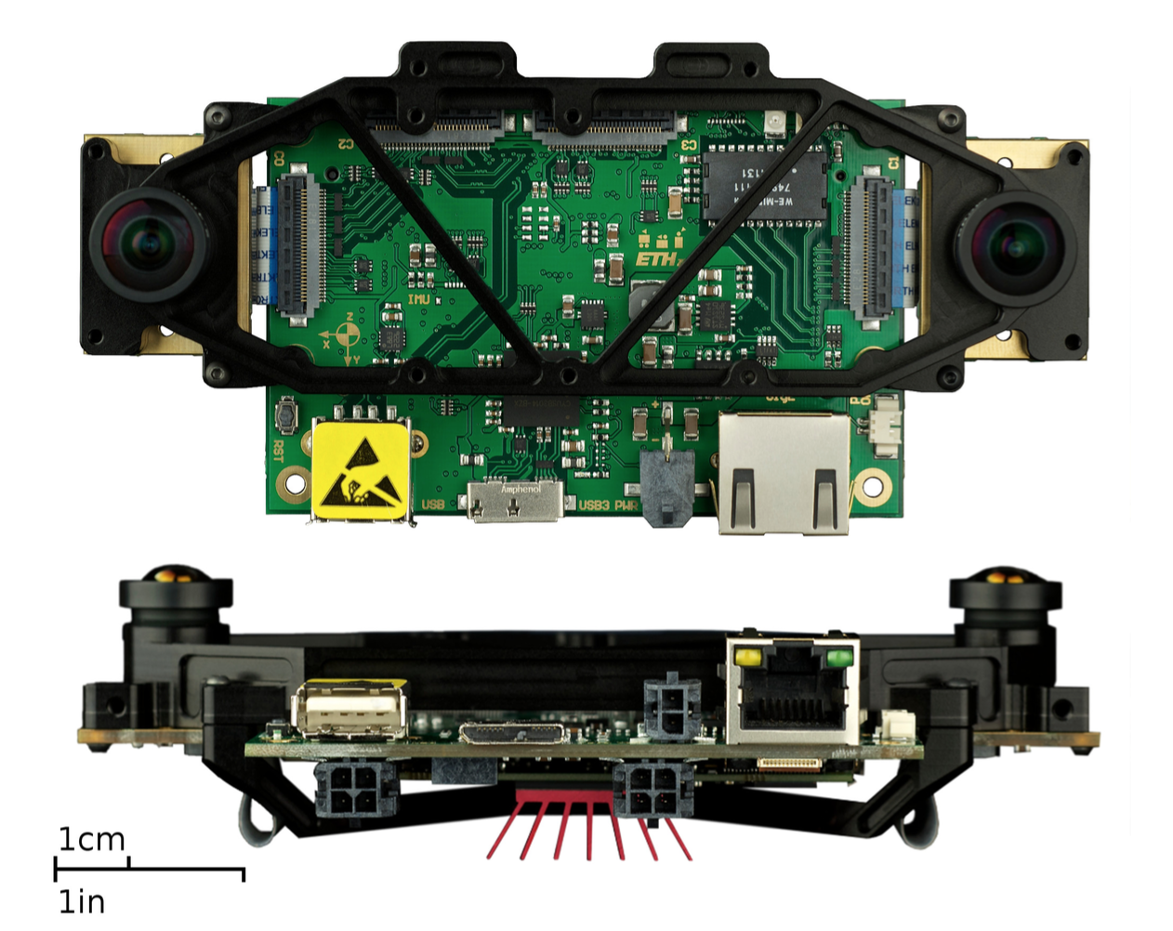
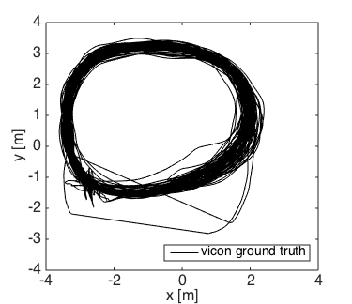
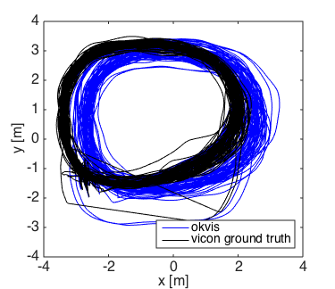
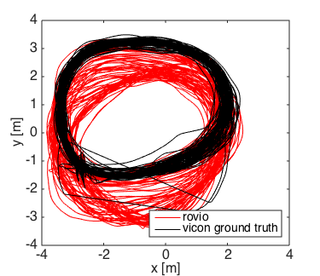
Comparison – Data
ROVIO and OKVIS
Time-Synchronization
Outlook
Start /
Endpoint
[Nikolic et al., ICRA, 2014]
Collected with vi-sensor
Long trajectory: 1200 meter in 100 loops
Dynamics: 2 m/s, 3 rad/s

Slide 8
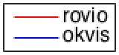
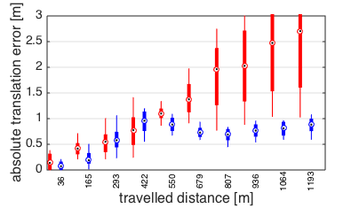
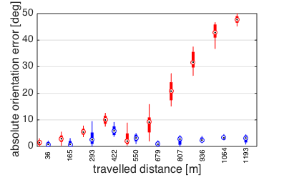
Global Accuracy
ROVIO and OKVIS
Time-Synchronization
Outlook
2.5 m / 1000 m
< 1 m / 1000 m
45° / 1000 m
4° / 1000 m

Slide 9
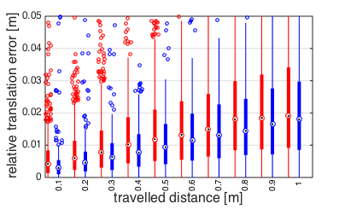
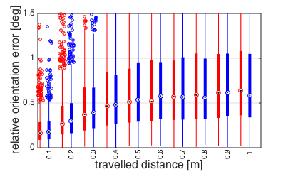
Local Accuracy
ROVIO and OKVIS
Time-Synchronization
Outlook
2 cm / 1 m
2 cm / 1 m
0.6° / 1 m
0.6° / 1 m

Slide 10
Results
ROVIO and OKVIS
Time-Synchronization
Outlook
ROVIO | OKVIS
 | + Global Accuracy
+ Local Accuracy | + Local Accuracy
+ Efficiency
+ Practicability

Slide 11
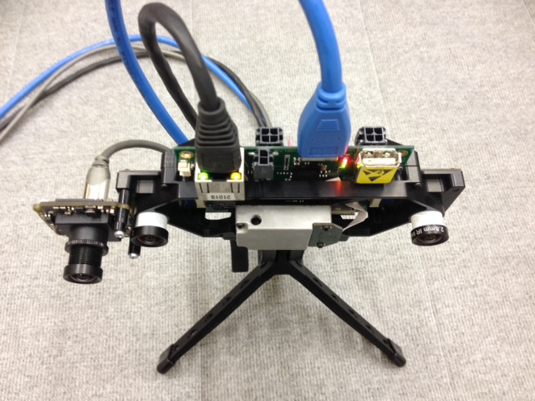
Towards non-timesynchronized Hardware
ROVIO and OKVIS
Time-Synchronization
Outlook

Slide 12
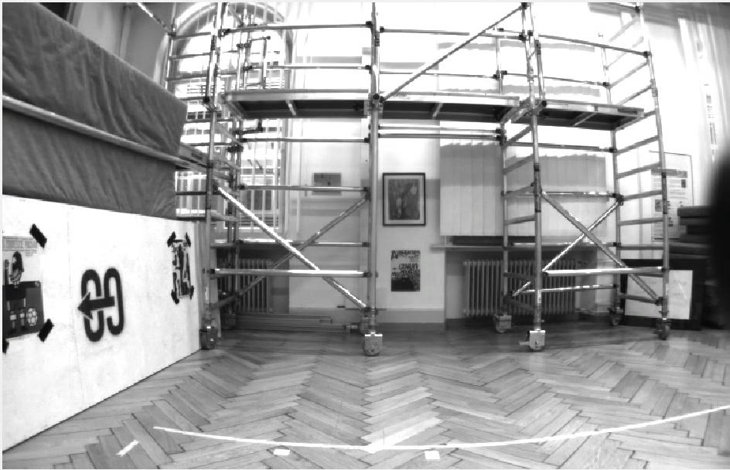
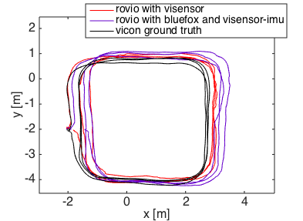
Slow Dataset
ROVIO and OKVIS
Time-Synchronization
Outlook
Dynamics: 1.5 m/s, 1 rad/s
Non-timesynchronized hardware is able to track
Vi-sensor performs better

Slide 13
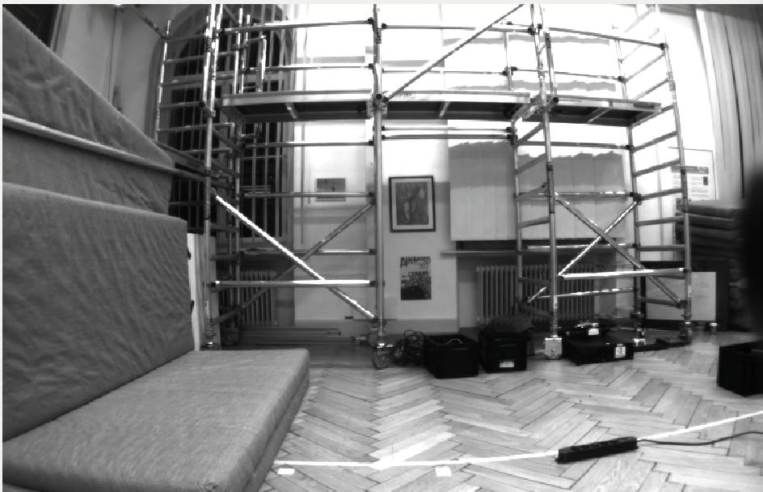
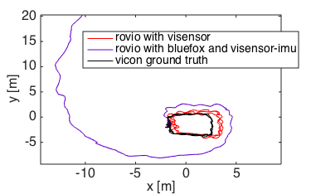
Fast Dataset
ROVIO and OKVIS
Time-Synchronization
Outlook
Fast, shaky motions
Dynamics: 2.5 m/s, 5 rad/s

Slide 14
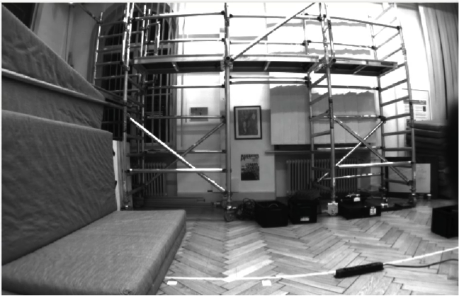
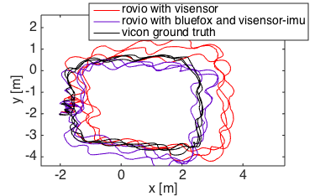
Fast Dataset – Fixed Extrinsics
ROVIO and OKVIS
Time-Synchronization
Outlook
Fixing the extrinsics can increases ROVIO performance on non-timesynchronized hardware

Slide 15
Outlook
ROVIO and OKVIS
Time-Synchronization
Outlook
Outlook
Global optimization for ROVIO and OKVIS
Run ROVIO and OKVIS with lower quality, non-timesynchronized hardware

Slide 16
Thank you !

Slide 17
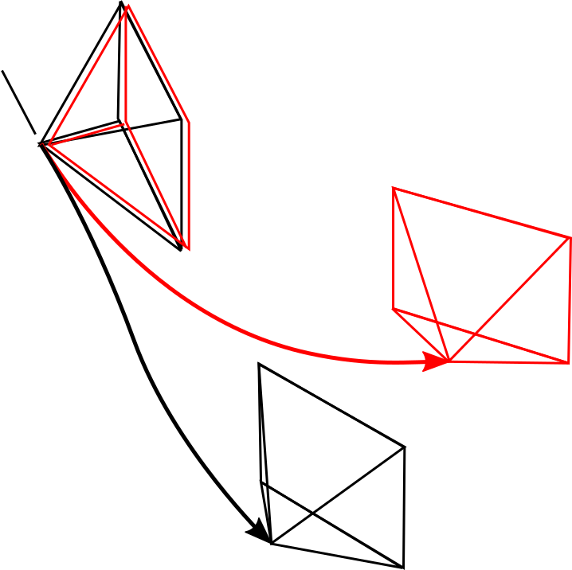
Global Accuracy
ROVIO and OKVIS
Time-Synchronization
Outlook
2.5 m / 1000 m
< 1 m / 1000 m
45° / 1000 m
4° / 1000 m

Slide 18
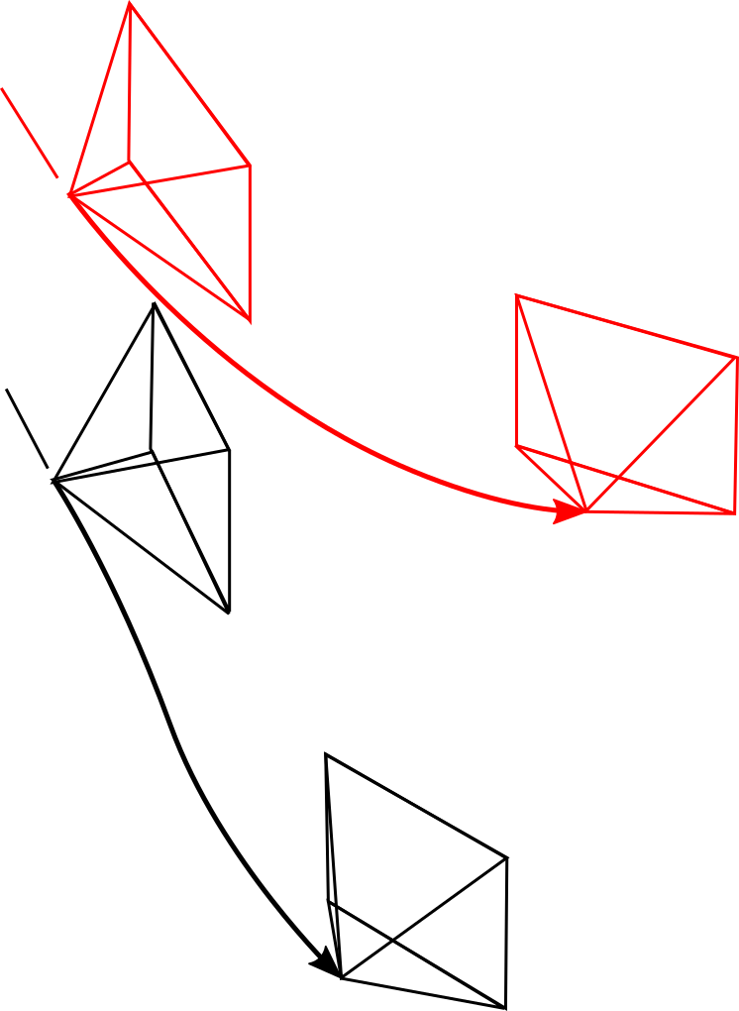
Local Accuracy
ROVIO and OKVIS
Time-Synchronization
Outlook
2 cm / 1 m
2 cm / 1 m
0.6° / 1 m
0.6° / 1 m

Slide 19
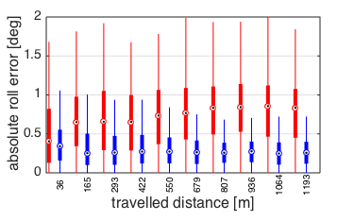
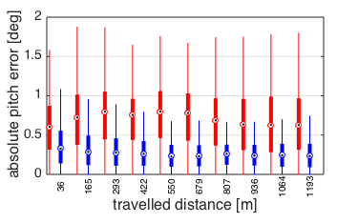
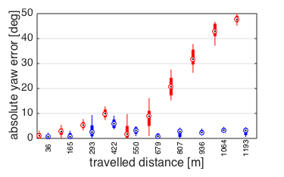
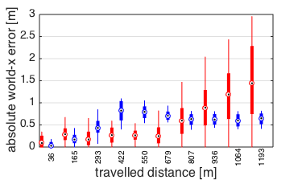
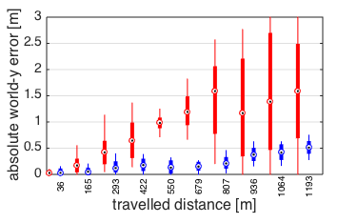
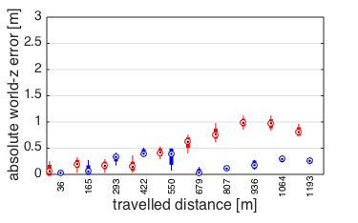
Global Accuracy – Separated Axes

Slide 20
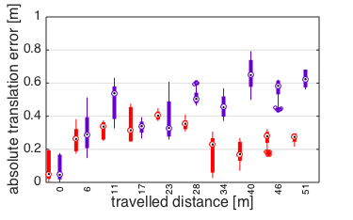
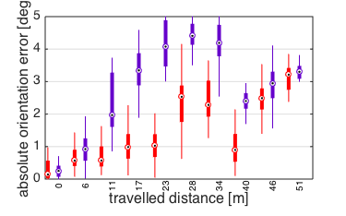
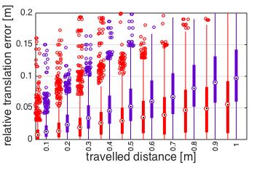
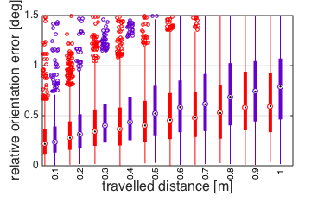
Slow Dataset

Slide 21
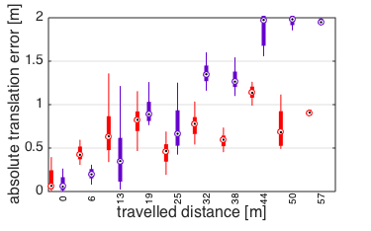
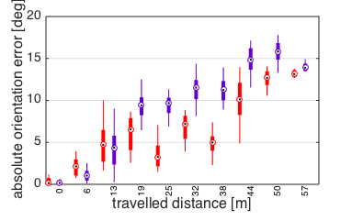
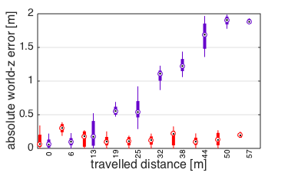
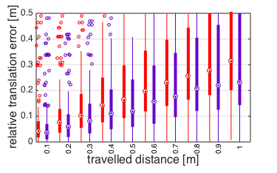
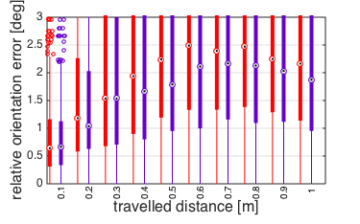
Fast dataset – Fixed Extrinsics

Slide 22
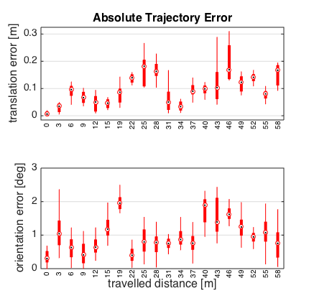
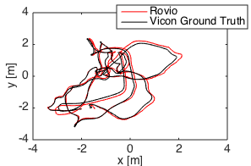
Global Accuracy ROVIO – Euroc Data

Slide 23
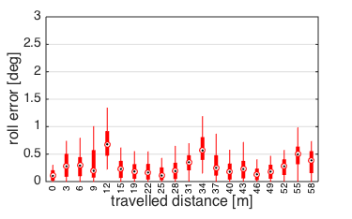
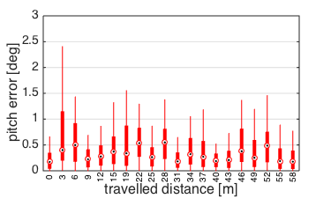
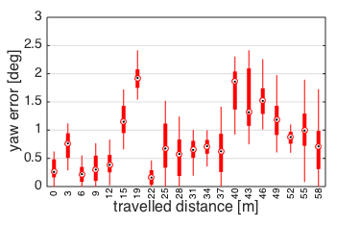
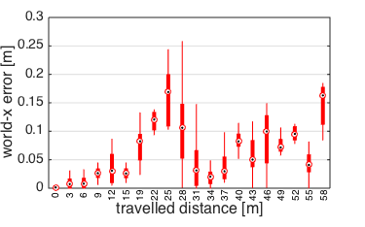
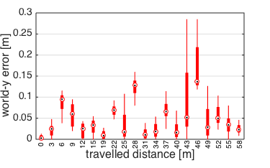
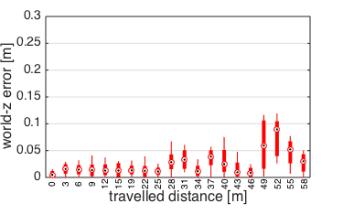
Global Accuracy ROVIO – Euroc Data
AOE_Yaw = 1 deg / 50 m
ATE_Z = 5 cm / 50 m (0.1 %)

Slide 24
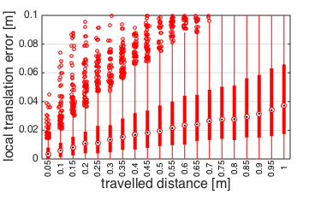
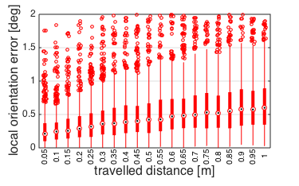
Local Accuracy ROVIO – Euroc Data
RTE = 4 cm / 1 m (4 %)
ROE = 0.6° / 1 m

Slide 25
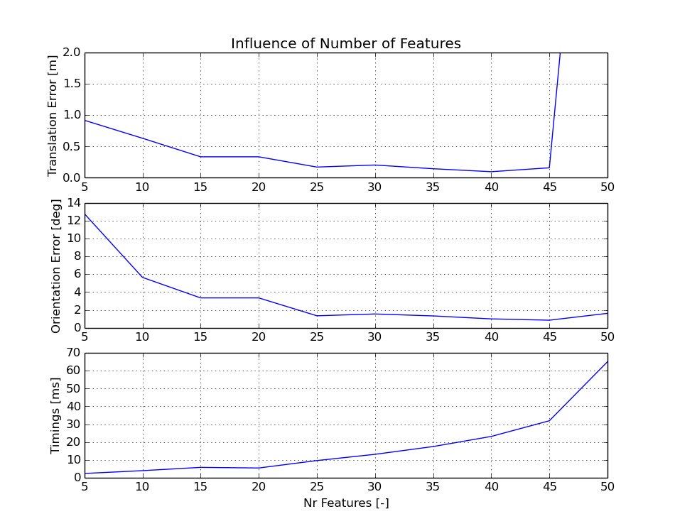
Computational Complexity / Features – Euroc Data

Slide 26


Towards non-timesynchronized Hardware
ROVIO and OKVIS
Time-Synchronization
Outlook
1) Analysis with artificial bias on IMU timestamp

